Slide 1

Debugging Sometimes you can’t avoid it
Pietro Berkes and Lisa Schwetlick

Slide 2

The agile development cycle
Write tests to check that feature works
Write simplest code that makes tests pass
Run tests and debug until all tests pass
Refactor and optimize only if necessary
Pick your next feature
pytest
pdb
timeit
cProfile
line_profiler

Slide 3

Debugging
The best way to debug is to avoid bugs
By writing tests, you anticipate the bugs
Your test cases should already exclude a big portion of the possible causes
Core idea in debugging: you can stop the execution of your application at the bug, look at the state of the variables, and execute the code step by step
Avoid littering your code with print statements
Notes:
Bugs are inevitable

Slide 4

pdb, the Python debugger
Command-line based debugger
pdb opens an interactive shell, in which one can interact with the code
examine and change value of variables
execute code line by line
set up breakpoints
examine calls stack

Slide 5

Hands-on example!
Debugging from python
Debugging from Jupyter
Debugging from an IDE

Slide 6

Entering the debugger
Enter debugger at the start of a file: python –m pdb myscript.py
Enter at a specific point in the code (easy alternative to print):
# some code here # the debugger starts here breakpoint() # rest of the code

Slide 7

Entering the debugger from Jupyter
%pdb – preventive
%debug – post-mortem

Slide 8
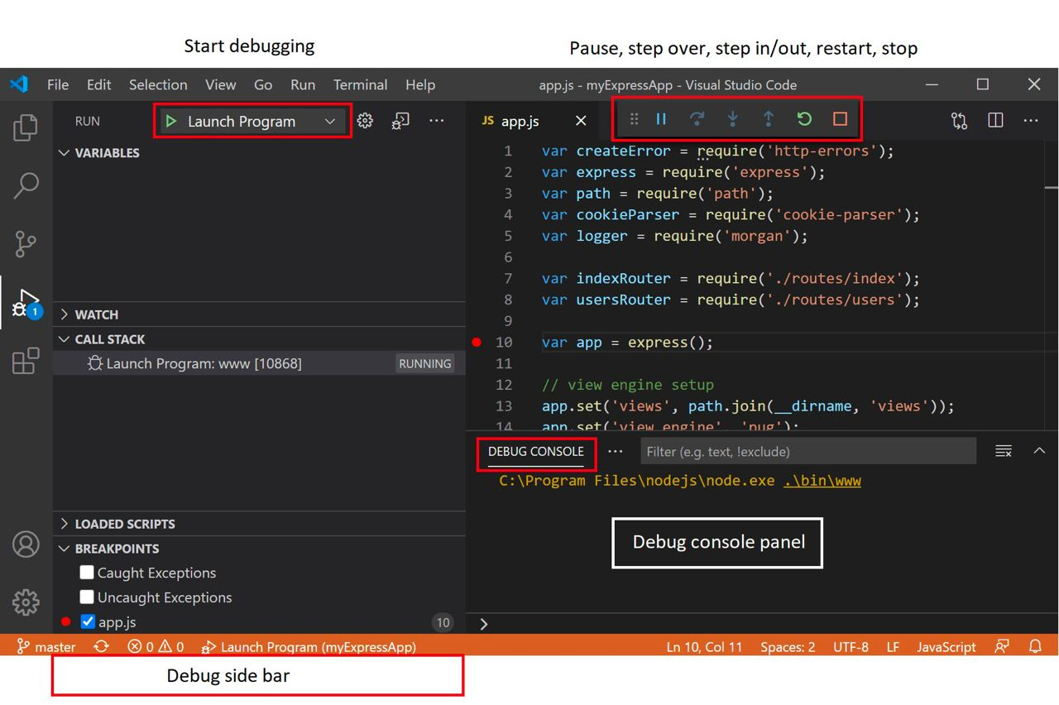

Entering the debugger from VSCode

Slide 9

Hands-on!
Go to bug_hunt/file_datastore.py and execute it
It fails! But… it works when the base_path is an absolute path :-(
data = b'A test! 012' datastore = FileDatastore(base_path='./datastore') datastore.write('a/mydata.bin', data) # This should pass! assert os.path.exists('./datastore/a/mydata.bin’)

Slide 10
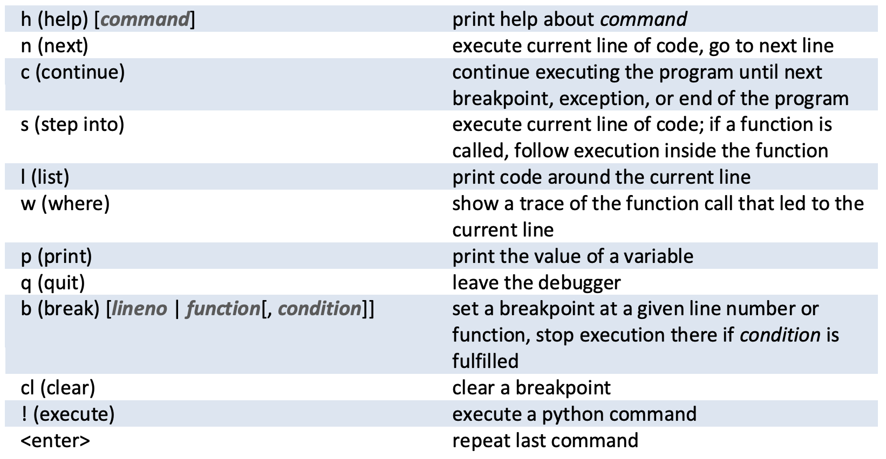
Hands-on!
Fix the bug in file_datastore.py, using the debugger
Submit a PR for issue #1 in the repository
pdb cheatsheet

Slide 11

Static checking and linting
One of the problems with debugging in Python is that most bugs only appear when the code executes.
“Static checking” tools analyze the code without executing it.
pep8: check that the style of the files is compatible with PEP8
pyflakes: look for errors like defined but unused variables, undefined names, etc.
flake8: pep8 and pyflakes in a single, handy command
and also: yapf, black, …
Notes:
Run flake8 on the *initial* pyanno code.

Slide 12

Hands-on!
Run flake8 on one the files you edited today

Slide 13
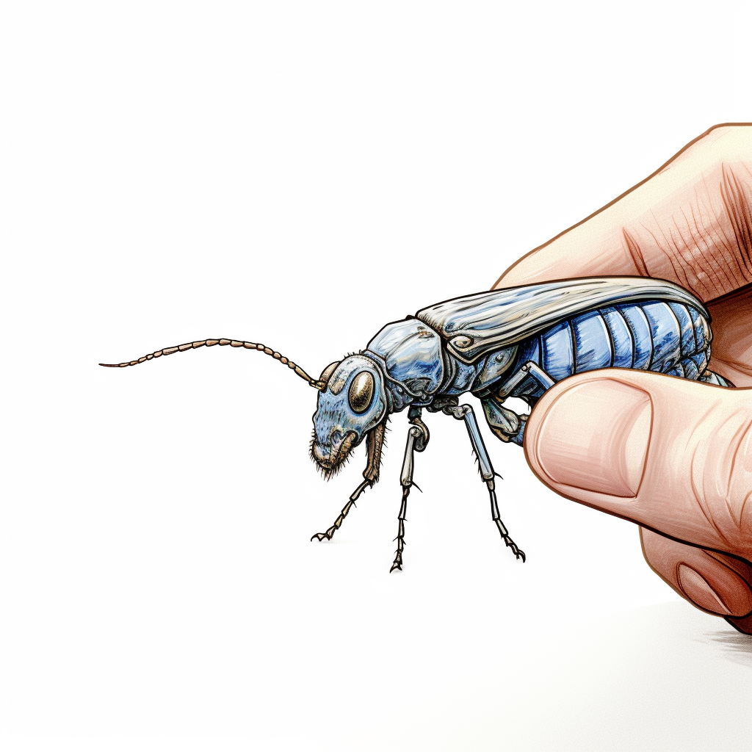
How to react to a bug
Add a test that matches the behavior you expect. It will fail and reproduce the bug
Debug and fix the the bug
Run the tests until they all pass (go back to 2 if necessary)
Now your bug is fixed *and* it will never occur again!

